Slide 1

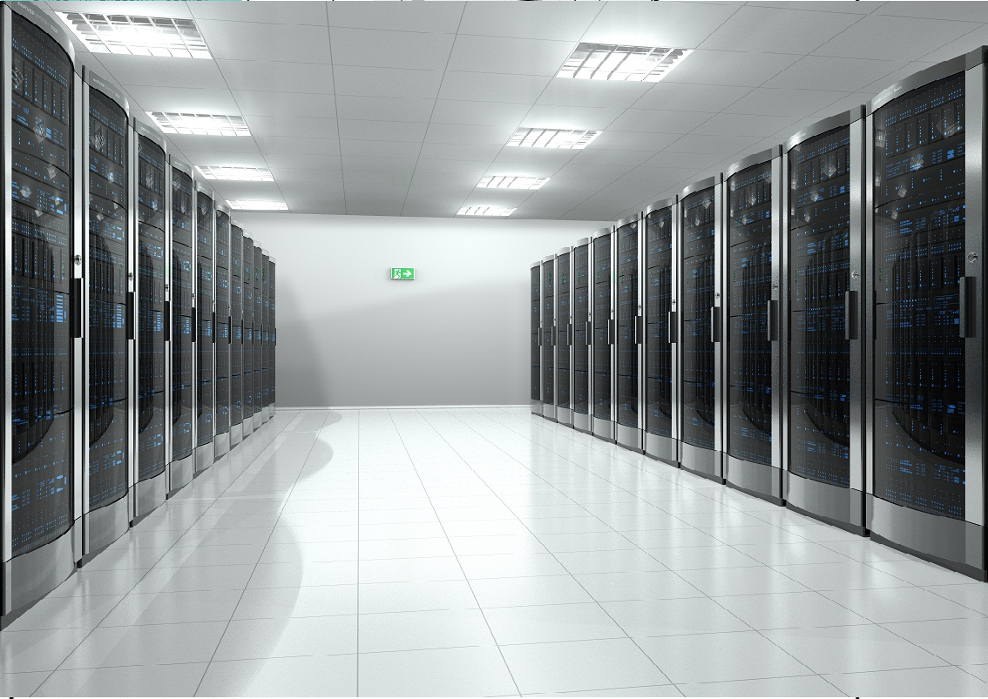
Introduction to Cloud Computing
Presented by:
Justice Opara-Martins (AMBCS)
Doctoral Researcher in Cloud Computing
Unit Title: Computers and Networks (Lecture Notes)
Time: 12:00 PM
Faculty of Science and Technology
Creative Technology Research Centre (CTRC)
Bournemouth University, UK
www.bournemouth.ac.uk Monday 13th February 2017 Kimmeridge Lecture Theatre (KG01)

Slide 2



Table of Content
Introduction to Cloud Computing
Essential Characteristics
Cloud Networks
Cloud Deployment Models
Cloud Delivery Mechanisms
Business Drivers for Cloud Adoption
Cloud Computing Risks
Migration from Traditional IT to Clouds
Conclusion
Q&A
www.bournemouth.ac.uk Monday 13th February 2017 Kimmeridge Lecture Theatre (KG01)

Slide 3
Objectives
After completing this talk, you should be familiar with:
Cloud computing definition
Describing cloud computing in one sentence
Factors that lead to the adoption of cloud computing
Explaining cloud concepts such as, infrastructure as a service, platform as a service, and software as a service
Business benefits of cloud computing for IT, application development, and testing
Describing cloud computing deployment models
Identifying cloud computing adoption risks
Differentiating between traditional IT and cloud computing services.
www.bournemouth.ac.uk Monday 13th February 2017 Kimmeridge Lecture Theatre (KG01)

Slide 4
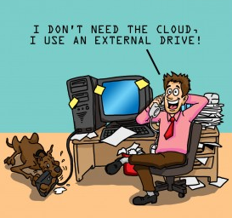
Are we using the cloud yet?
www.bournemouth.ac.uk Monday 13th February 2017 Kimmeridge Lecture Theatre (KG01)

Slide 5
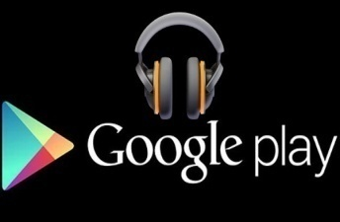

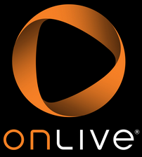
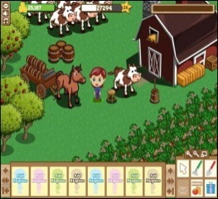

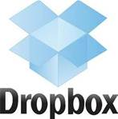
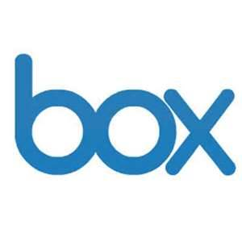
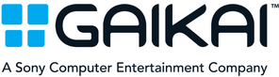
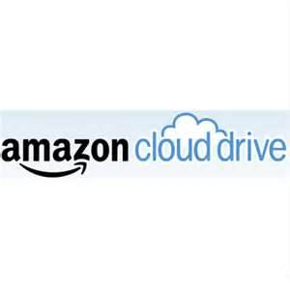
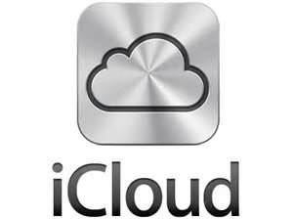

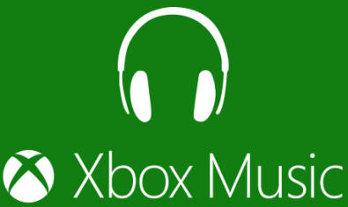



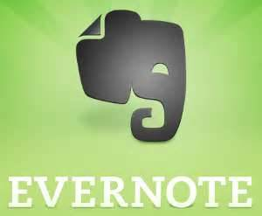
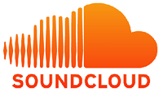
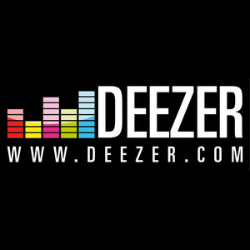
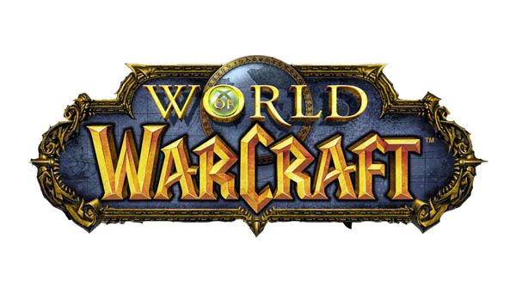

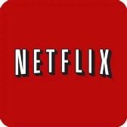
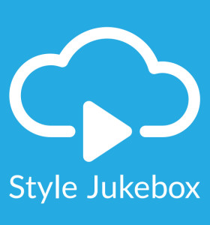

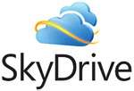
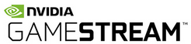
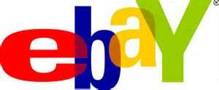
Are we using the cloud yet?
www.bournemouth.ac.uk Monday 13th February 2017 Kimmeridge Lecture Theatre (KG01)

Slide 6

Cloud computing is a new way of thinking when delivering IT enabled business services like application development and test.
What is Cloud Computing – Part 1
Cloud is:
Cloud enables:
A new consumption and delivery model inspired by consumer Internet services
End-user focused
Self-service
Sourcing options
Economies of scale
Cloud is essentially an IT consumption and delivery model that is optimized by workload
www.bournemouth.ac.uk Monday 13th February 2017 Kimmeridge Lecture Theatre (KG01)
Notes:
Ask five different students/end-users/companies what cloud computing is and you may get five different answers. How do we define cloud? In a nutshell cloud computing is essentially an IT consumption and delivery model that is optimized by workload.
Inspired by consumer Internet services (online banking, for example) and industrialization in traditional areas (sharing power from a grid is essentially a precursor to cloud computing), the cloud is a “power grid” for IT-supported services.
It’s a way for end users to get the services they need and provide businesses with economies of scale, and it’s a way to handle workloads in the way that is best for your individual business. Some workloads are ideal for the cloud—some may not be. But that model can change from year to year, or even month to month. And at IBM, the cloud is not one monolithic entity. Several types of clouds coexist, often in one business environment—private clouds, public clouds and virtually any number of combinations of the two.
What else is cloud?
6

Slide 7
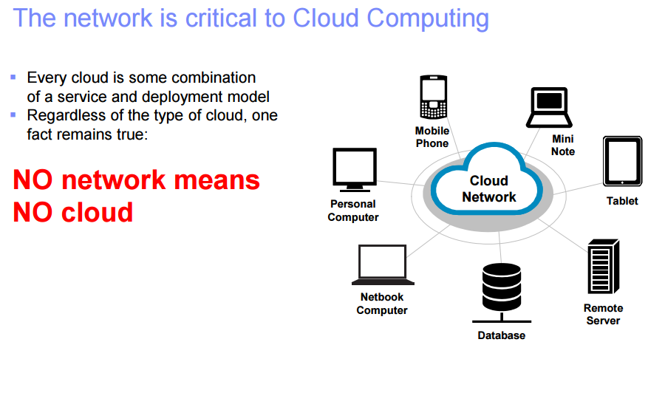
Cloud Computing Network
Without Network:
Users cannot access their cloud services.
Applications, data, and users cannot move between clouds.
The infrastructure components that must work together to create a cloud cannot.
www.bournemouth.ac.uk Monday 13th February 2017 Kimmeridge Lecture Theatre (KG01)
Notes:
From a networking standpoint, each service model requires the cloud provider to expose part or all of the network, and provide more or less networking capabilities to cloud users.
Each service model requires cloud users to understand and design more or less of the network to which they are exposed.
The network is most exposed in the IaaS model, and least exposed in the SaaS model.
Without networks, users cannot access their cloud services. Without networks, applications, data, and users cannot move between clouds. Without networks, the infrastructure components that must work together to create a cloud cannot.

Slide 8
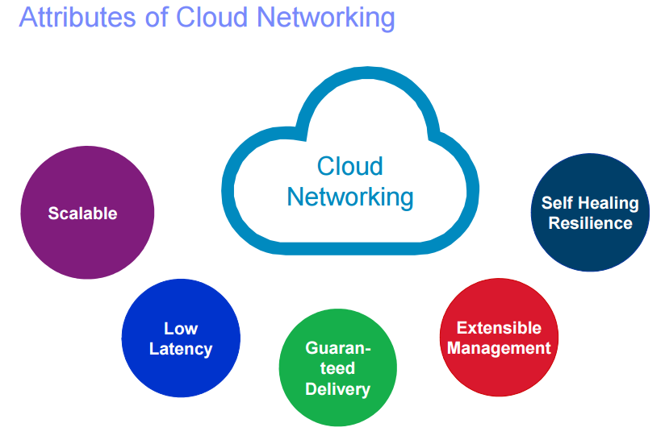
Attributes of Cloud Networking
Scalability: The cloud network must scale to the overall level of throughput required to ensure that it does not become a bottleneck.
Low Latency: The cloud network must deliver microsecond latency across the entire network fabric because low latency improves application performance and server utilization.
Guaranteed Performance: The cloud network must provide predictable performance to service many simultaneous applications in the network, including video, voice, and web traffic.
Extensible Management: Real-time upgrades and image/patch management in a large cloud-network is a daunting challenge to network administrators.
Self-Healing Resilience: Cloud networks operate 24x7, so downtime is not an option. This requires a network architecture that offers self-healing and the ability for transparent in-service software updates.
www.bournemouth.ac.uk Monday 13th February 2017 Kimmeridge Lecture Theatre (KG01)
Notes:
Extensible Management: Real-time upgrades and image/patch management in a large cloud-network is a daunting challenge to network administrators. A vastly simpler approach is required to handle networks of this size, which automates provisioning, monitoring, maintenance, upgrading, and troubleshooting.

Slide 9

What is Cloud Computing – Part 2
Computing power
Applications
Networking
Data storage
Services
www.bournemouth.ac.uk Monday 13th February 2017 Kimmeridge Lecture Theatre (KG01)

Slide 10
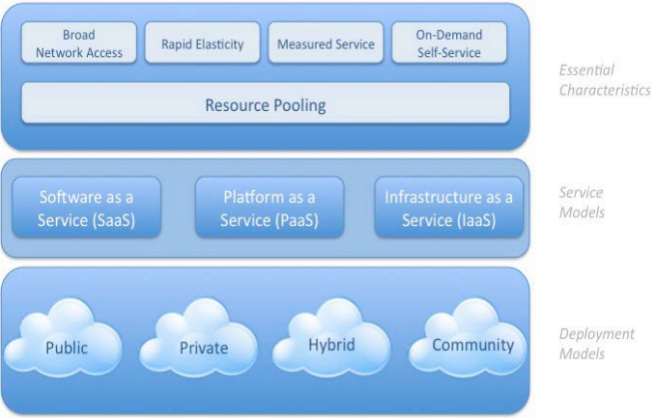
Visual Model of Cloud Computing Definition
www.bournemouth.ac.uk Monday 13th February 2017 Kimmeridge Lecture Theatre (KG01)
Notes:
Cloud computing is composed of five essential characteristics; four deployment models that are represented as layers in the cloud technology stack: ranging from the cloud infrastructure (Infrastructure as a Service or IaaS); cloud application platform (Platform as a Service or PaaS); and cloud application (Software as a Service or SaaS) (Marks and Lozano, 2010).
Figure above shows such a structure. Classifying cloud-computing services along with different layers is common practice in the industry.

Slide 11
Cloud Computing: Essential Characteristics
On-demand self service
Users automatically access computing resources (e.g. servers, storage etc.) as needed.
Broad network access
Services available over the network can be accessed using mobile/smart phones, tablets, laptops and desktops.
Resource pooling
Computing resources (including memory and bandwidth) can be pooled to serve multiple customers at the same time.
Location independence
Rapid elasticity
Ability to quickly scale in/out service with demand, at any time.
Measured service
Control, optimise services based on metering (i.e. pay-per-use pricing model)
Type of service include storage, processing, bandwidth etc.
www.bournemouth.ac.uk Monday 13th February 2017 Kimmeridge Lecture Theatre (KG01)

Slide 12
Cloud Service Models
IaaS
Infrastructure as a service
Provision servers
Storage
Networking resources
PaaS
Platform as a service
Middleware platform
Solution stack
Both accessible over a network
SaaS
Software as a service
Software
Applications
Or services that are delivered over a network
www.bournemouth.ac.uk Monday 13th February 2017 Kimmeridge Lecture Theatre (KG01)

Slide 13
Infrastructure as a service (IaaS) architecture
An infrastructure provider (IP) makes an entire computing infrastructure available “as a service”
Manages a large pool of computing resources and uses virtualization to assign and dynamically resize customer resources
Customers rent processing capacity, memory, data storage, and networking resources that are provisioned over a network
www.bournemouth.ac.uk Monday 13th February 2017 Kimmeridge Lecture Theatre (KG01)

Slide 14
Platform as a service (PaaS) architecture
Service provider (SP) supplies the software platform or middleware where the applications run
Service user is responsible for the creation, updating, and maintenance of the application
The sizing of the hardware that is required for the execution of the software is made in an understandable manner
www.bournemouth.ac.uk Monday 13th February 2017 Kimmeridge Lecture Theatre (KG01)

Slide 15
Software as a service (SaaS) architecture
Service provider (SP) is responsible for the creation, updating, and maintenance of software and application
Service user accesses the service through Internet-based interfaces
www.bournemouth.ac.uk Monday 13th February 2017 Kimmeridge Lecture Theatre (KG01)

Slide 16
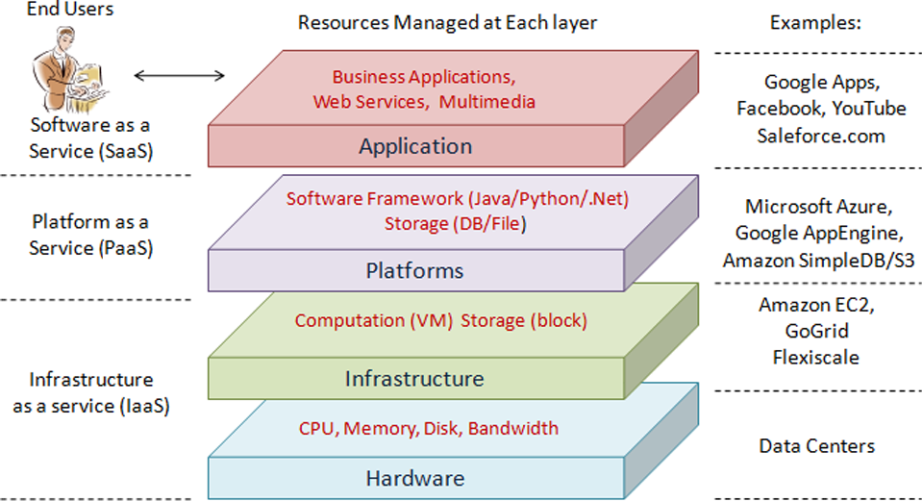
Cloud Layer Architecture
www.bournemouth.ac.uk Monday 13th February 2017 Kimmeridge Lecture Theatre (KG01)

Slide 17
Split of Responsibilities: provider-side and consumer-side
Traditional
on-premises
Infrastructure as a service
Platform as a service
Software as a service
Applications
Applications
Applications
Applications
Data
Data
Data
Data
Runtime
Runtime
Runtime
Runtime
Middleware
Middleware
Middleware
Middleware
O/S
O/S
O/S
O/S
Virtualization
Virtualization
Virtualization
Virtualization
Servers
Servers
Servers
Servers
Storage
Storage
Storage
Storage
Networking
Networking
Networking
Networking
Client manages
Vendor manages in the cloud
www.bournemouth.ac.uk Monday 13th February 2017 Kimmeridge Lecture Theatre (KG01)

Slide 18
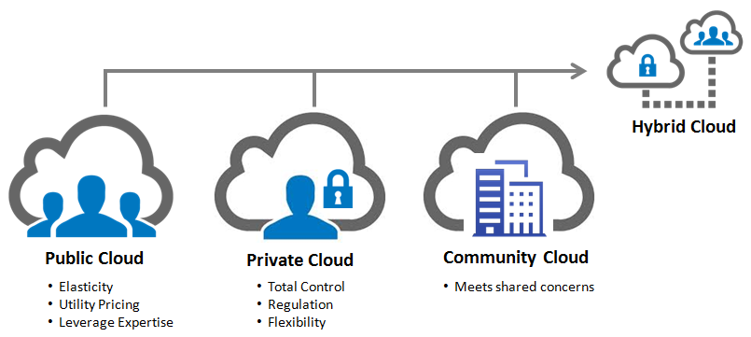
Cloud Deployment Models
Multiple clouds coexist:
Private, public, community and hybrid
www.bournemouth.ac.uk Monday 13th February 2017 Kimmeridge Lecture Theatre (KG01)

Slide 19
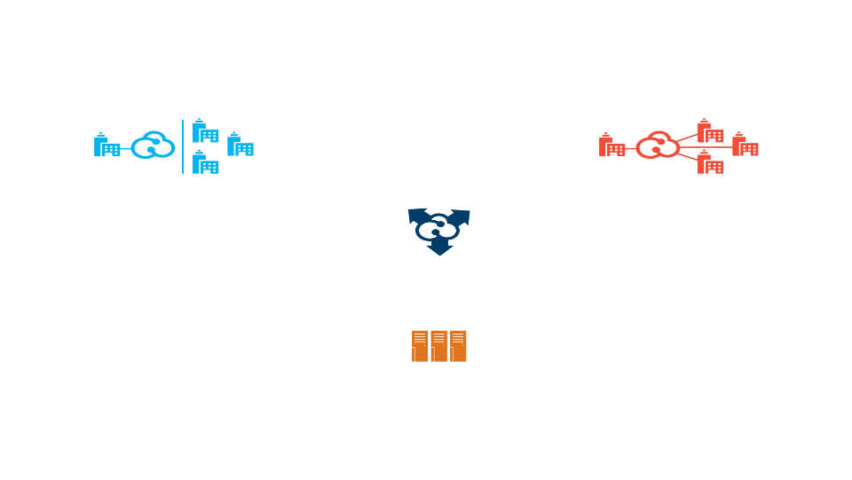
Cloud Deployment Models
Customers are choosing a variety of cloud models to meet their unique needs and priorities
Private cloud
Public cloud
On or off premises cloud infrastructure operated solely for an organization and managed by the organization or a third party
Hybrid Cloud
Available to the general public or a large industry group and owned by an organization selling cloud services.
Traditional IT and clouds (public and/or private) that remain separate but are bound together by technology that enables data and application portability
Community Clouds
Provisioned for exclusive use by specific consumers with shared concerns (e.g. security requirements, policy, and compliance considerations).
It may be owned, managed, and operated by one or more of the organizations in the community.
Traditional IT
Appliances, pre-integrated systems and standard hardware, software, and networking.
www.bournemouth.ac.uk Monday 13th February 2017 Kimmeridge Lecture Theatre (KG01)
Notes:
Private cloud: A private cloud reproduces the delivery models of a public cloud behind a firewall for the exclusive benefit of an organization and its customers. The self-service management interface is still in place, while the IT infrastructure resources being collected are internal.
Public cloud: A public cloud is an environment that exists outside a company's firewall, such as a service that a third-party vendor offers. It is also referred to as a shared or multitenanted, virtualized infrastructure managed by means of a self-service portal.
Hybrid cloud: In a hybrid cloud environment, external services are leveraged to extend or supplement an internal cloud.
Traditional IT: Consists of appliances, pre-integrated systems and standard hardware, software and networking.

Slide 20
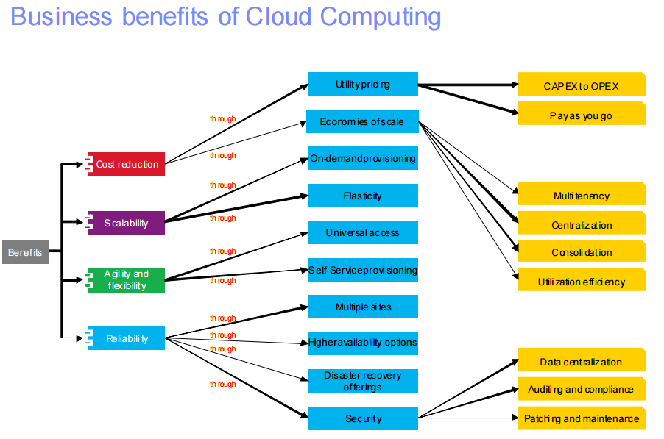
Business Benefits of Cloud Computing
Potential benefits of cloud computing from a business perspective.
Note, benefits will vary depending on several factors including use case, workload, cloud provider, capabilities, and so on.
www.bournemouth.ac.uk Monday 13th February 2017 Kimmeridge Lecture Theatre (KG01)

Slide 21
The Importance of Cloud Computing for Development and Test
Traditional
Reduced installation and administration costs
Lower TCO by improved utilization of software assets
Better governance through standardized delivery of services
Preconfigured software embodying best practices
Tools can be provisioned in minutes. No download, installation or setup.
Self-administered portal to access to software resources for a globally distributed team
High deployment costs to deliver software
Control and governance chaos in software processes
Onramp and on-boarding of teams reduces time to software delivery
www.bournemouth.ac.uk Monday 13th February 2017 Kimmeridge Lecture Theatre (KG01)

Slide 22

IT Benefits from Cloud Computing
Results from IBM cloud computing engagements
Increasing speed and flexibility
Test provisioning | Weeks | Minutes
Change management | Months | Days/hours
Release management | Weeks | Minutes
Service access | Administered | Self-service
Standardization | Complex | Reuse/share
Metering/billing | Fixed cost | Variable cost
Server/storage utilization | 10–20% | 70–90%
Payback period | Years | Months
Reducing costs
SOURCE: Based on IBM and client experience.
www.bournemouth.ac.uk Monday 13th February 2017 Kimmeridge Lecture Theatre (KG01)
Notes:
22
So how are real customer situations realizing benefits from the cloud. We’ve compiled here a list of the ways that customers are reporting that they’ve been able to see real, tangible results form their cloud delivered implementations.
Why can a cloud environment have this kind of effect? The key is that the cloud is based on three essential fundamentals: It’s standardized, it’s virtualized and it’s automated. That’s how you can provide scalable services. That’s the way you’re going to see efficiency. And that’s the way you’re going to drive down costs and improve service. That’s really a pretty simple equation, and we are seeing clients that are doing this achieve very real, measurable business results.
For example:
Virtualization of IT resources—servers, storage, networks and applications—are pooled and virtualized to help provide an implementation-independent, efficient infrastructure with elastic scaling, meaning the environments can scale up and down by large factors as demand changes.
Automation through a self-service portal and automated provisioning
Standardization of pricing, processes and services

Slide 23
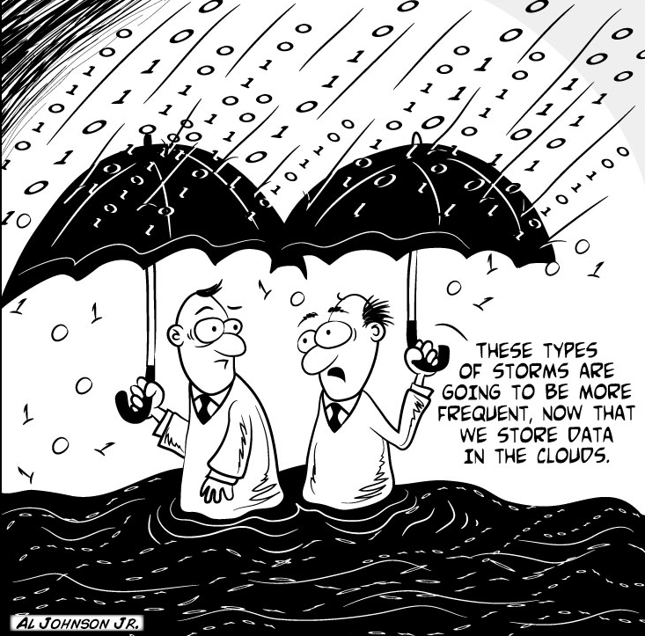
Current thoughts on Cloud Computing Adoption Risks
Shifting computing power to the cloud brings many benefits.
such as: Cost savings, scalability, increased agility in software deployment etc.
But don’t ignore the risks
www.bournemouth.ac.uk Monday 13th February 2017 Kimmeridge Lecture Theatre (KG01)

Slide 24
Categories of Cloud Computing Risks
Less Control
Many companies and governments are uncomfortable with the idea of their information located on systems they do not control. Providers must offer a high degree of security transparency to help put customers at ease.
Technology Immaturity
Lack of world-wide adopted Standards. Use of closed proprietary technologies. Lack of knowledge and trust.
API Jungle.
Legal uncertainties.
Data Security
Migrating workloads to a shared network and compute infrastructure increases the potential for unauthorized exposure. Authentication and access technologies become increasingly important.
Vendor Lock-in
Interoperability constraints.
Low level of portability of application and services based on cloud.
Contract and exit strategies
Limitations on sharing or transferring data
Compliance
Complying with SOX, HIPAA and other regulations may prohibit the use of clouds for some applications. Comprehensive auditing capabilities are essential.
Security Management
Providers must supply easy controls to manage firewall and security settings for applications and runtime environments in the cloud.
Reliability
High availability will be a key concern. IT departments will worry about a loss of service should outages occur. Mission critical applications may not run in the cloud without strong availability guarantees.
www.bournemouth.ac.uk Monday 13th February 2017 Kimmeridge Lecture Theatre (KG01)
Notes:
Key point: Some concerns are more relevant to the cloud than others, these are the most frequently discussed.
Less control: Uncomfortable with the idea of their information on systems they do not own in-house.
Data Security: A shared, multi-tenant infrastructure increases potential for unauthorized exposure. Especially in the case of public-facing clouds.
Reliability: They are worried about service disruptions affecting the business.
Compliance: Regulations may prohibit the use of clouds for certain workloads and data.
Security Management: How will today’s enterprise security controls be represented in the cloud?

Slide 25





Security is among a top concern with cloud computing...
Cloud Computing Security Risks
Application and process
Help keep applications secure, protected from malicious or fraudulent use, and hardened against failure
People and identity
Mitigate the risks associated with user access to corporate resources
Network, server and end point
Optimize service availability by mitigating risks to network components
Data and information
Understand, deploy and properly test controls for access to and usage of sensitive data
Physical infrastructure
Provide actionable intelligence on the desired state of physical infrastructure security and make improvements
Professional services
Managed services
Hardware and software
www.bournemouth.ac.uk Monday 13th February 2017 Kimmeridge Lecture Theatre (KG01)
Notes:
25
Multiple surveys have shown that the top inhibitor to moving forward with cloud computing is security.
There are 5 unique security focus areas in cloud computing that we speak about and that we have organized our discussions around, and each of these elements aligns directly with an element of Gartner’s view of what security elements are most critical in cloud computing.
People and Identity Mitigate the risks associated with user access to corporate resources
Data and Information Understand, deploy and properly test controls for access to and usage of sensitive business data
Application and Process Keep applications secure, protected from malicious or fraudulent use, and hardened against failure
Network, Server and End Point Optimize service availability by mitigating risks to network components
Physical Infrastructure Provide actionable intelligence on the desired state of physical infrastructure security and make improvements

Slide 26



How can consumers think about their Cloud journey?
Build
Design and construct
Quality assurance (test)
Security and compliance
Lifecycle management
Plan
Understand strategic direction
Analyze workloads (apps. data etc.)
Determine delivery model
Define architecture
Build the business case
Deliver
Deploy
Consume
Manage
Optimize
www.bournemouth.ac.uk Monday 13th February 2017 Kimmeridge Lecture Theatre (KG01)
Notes:
26
So how do you get started with cloud computing?
We believe that to best leverage cloud computing as a viable delivery model, is to layout a clear path that is grounded in integrating cloud with your overall IT delivery strategy. You can build and deliver cloud services, or you can acquire and deliver cloud services, but both should appropriately start with your planning stage where you align the cloud-based services with your overall strategic direction and you’ve analyzed which workloads are appropriate for cloud delivery and have at least a preliminary business case to support an implementation.

Slide 27




Create a roadmap for cloud as part of the existing IT optimization strategy
Standardize and automate
Standardize services
Reduce deployment cycles
Enable scalability
Flexible delivery
Virtualize
Remove physical resource boundaries
Increase hardware utilization
Reduce hardware costs
Simplify deployments
Consolidate
Reduce infrastructure complexity
Reduce staffing requirements
Manage fewer things better
Lower operational costs
www.bournemouth.ac.uk Monday 13th February 2017 Kimmeridge Lecture Theatre (KG01)
Notes:
27
27
Every business and organization today has a current plan of record for how they want IT to support their business. For many, it is about consolidating assets, virtualizing to increase asset utilizations and reduce costs, as well as standardizing and automating to improve service delivery and lower operational labor costs. These are key to achieving an optimal and effective cloud computing experience for the end user, and maximizing value to the business.

Slide 28
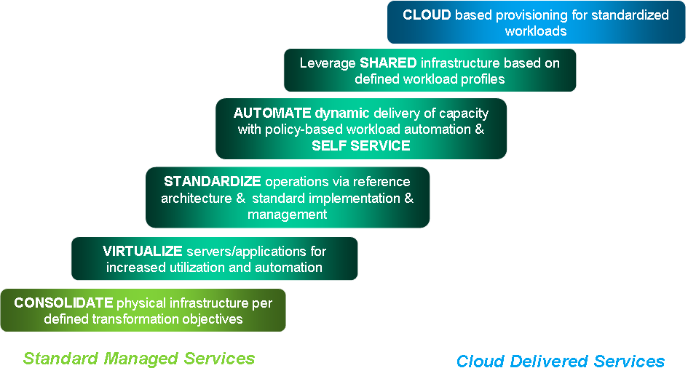
Movement from Traditional Environments to Cloud Can be in One Step or an Evolution
Clients will make workload-driven trade offs among functions such as security, degree of customization, control and economics
www.bournemouth.ac.uk Monday 13th February 2017 Kimmeridge Lecture Theatre (KG01)
Notes:
Progression toward transformation starts with optimizing existing assets/processes and leverages best in class technology at transitions
Each step balances improvements in efficiency and effectiveness and can be measured by business returns.
However, an organization can move to cloud systematically taking one step at a time, or they can move right to a cloud deployment if it aligns best with their strategic vision for the business.

Slide 29


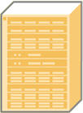
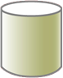


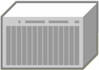

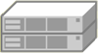

A New Model For Building Cloud Computing Environments
Cloud Computing Environment
Ensembles are scalable pools of computing power and storage that are manageable as single systems. They will replace multitudes of individual IT systems and reduce the labor required for physical systems management.
Stack Oriented
Ensemble
Ensemble
Servers
Networks
Disk
Tape
Ensemble
www.bournemouth.ac.uk Monday 13th February 2017 Kimmeridge Lecture Theatre (KG01)
Notes:
29
Creating a strong service oriented architecture is critical framework for supporting the business process, making deployment of new services easy and the ability to adapt and change the underlying components quickly and easily. These are the all tenants to having a dynamic infrastructure which is necessary to delivery Cloud Computing Services.
Because enterprises operation overhead has been the vast majority of expense CIOs have been challenged with and so over the years organizations have spent a tremendous amount of time and effort in simplifying their infrastructures with various technologies which allowed them to become more responsive to their business and their users. Unfortunately this has left few resources for implementing new architectures for new initiatives.
Cloud Computing offers the opportunity to leverage the investments the organizations have made. Virtualization and service management software can provide benefits harnessing the power of the heterogeneous environments which have been deployed.
By creating Ensembles of scalable pools of systems which are managed as single systems can greatly reduce the management of multitudes of individual servers to help improve productivity and labor it requires to administer these individual physical devices.
Building Ensembles from the existing devices deployed through virtual resource objects/appliances are essential to the benefits of Cloud Computing which is quickly building, responding and delivering services to the users of the Cloud Services.

Slide 30






Cloud is an opportunity—will you be able to take advantage?
Summary
Technology is enabling a smarter planet
We must face head-on the challenges to building an effective IT
Cloud computing is one key way to address the challenges of a smarter planet
www.bournemouth.ac.uk Monday 13th February 2017 Kimmeridge Lecture Theatre (KG01)
Notes:
We are in a unique point in the history of the planet and the ability of technology to solve problems and contribute to humanity—technology is enabling a smarter planet.
At the same time, we are faced with myriad challenges to creating the necessary IT infrastructure to move forward—cost pressures, finding talent, security, managing complexity, meeting the expectations of end users.
Cloud computing is a major shift in how we address the challenges of a smarter planet and the smarter infrastructure that supports it.
And this is a great point at which to explore your options with regard to cloud.
30

Slide 31
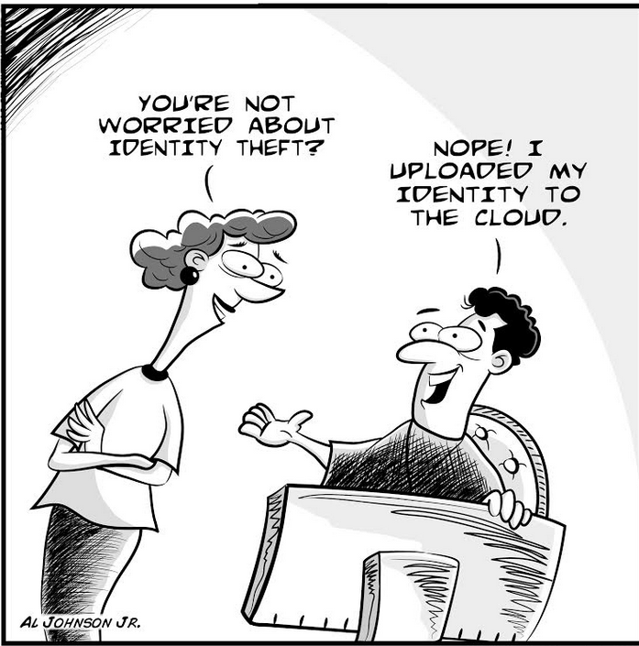
Conclusion
Cloud fears largely stem from the perceived loss of control of sensitive data.
Current control measures do not adequately address cloud computing’s third-party data storage and processing needs.
Looking to the future, adoption of cloud computing by enterprises will be driven by several factors including user preferences and business priorities.
Nonetheless, delays in adapting the current law to the cloud era may impede success of this technology
www.bournemouth.ac.uk Monday 13th February 2017 Kimmeridge Lecture Theatre (KG01)

Slide 32

Introduction to Cloud Computing – Q&A
www.bournemouth.ac.uk Monday 13th February 2017 Kimmeridge Lecture Theatre (KG01)

Slide 33
Question and Answers on Cloud Computing-1
Q.What is the main difference between Cloud Computing and traditional computing?
www.bournemouth.ac.uk Monday 13th February 2017 Kimmeridge Lecture Theatre (KG01)

Slide 34
Question and Answers on Cloud Computing-1
Q.What is the main difference between Cloud Computing and traditional computing?
A.The main difference lies in the usage of the IT resources - they are consumed as a service in a highly flexible form.
www.bournemouth.ac.uk Monday 13th February 2017 Kimmeridge Lecture Theatre (KG01)

Slide 35
Question and Answers on Cloud Computing-2
Q. What makes Cloud Computing attractive to customers?
www.bournemouth.ac.uk Monday 13th February 2017 Kimmeridge Lecture Theatre (KG01)

Slide 36
Question and Answers on Cloud Computing-2
Q. What makes Cloud Computing attractive to customers?
A. The greater efficiency leads to lower TCO (total cost of ownership).
www.bournemouth.ac.uk Monday 13th February 2017 Kimmeridge Lecture Theatre (KG01)

Slide 37
Question and Answers on Cloud Computing-3
Q. What makes Cloud Computing attractive to IT companies like Google, Amazon, Microsoft, and IBM?
www.bournemouth.ac.uk Monday 13th February 2017 Kimmeridge Lecture Theatre (KG01)

Slide 38
Question and Answers on Cloud Computing-3
Q. What makes Cloud Computing attractive to IT companies like IBM?
A. Because only big providers have the capabilities to deliver the services and also bear the responsibilities involved, cloud computing gives bigger IT companies a competitive advantage.
www.bournemouth.ac.uk Monday 13th February 2017 Kimmeridge Lecture Theatre (KG01)

Slide 39
Question and Answers on Cloud Computing-4
Q. What makes selling Cloud Computing as a service attractive to IT companies in contrast to selling the individual solution components hardware, software and services?
www.bournemouth.ac.uk Monday 13th February 2017 Kimmeridge Lecture Theatre (KG01)

Slide 40
Question and Answers on Cloud Computing-4
Q. What makes selling Cloud Computing as a service attractive to IT companies in contrast to selling the individual solution components hardware, software and services?
A. Selling IT services leads to a steady revenue stream in contrast to quarterly peaks.
www.bournemouth.ac.uk Monday 13th February 2017 Kimmeridge Lecture Theatre (KG01)

Slide 41
Question and Answers on Cloud Computing-5
Q. What environmental consequences do we expect from Cloud Computing?
www.bournemouth.ac.uk Monday 13th February 2017 Kimmeridge Lecture Theatre (KG01)

Slide 42
Question and Answers on Cloud Computing-5
Q. What environmental consequences do we expect from Cloud Computing?
A. The greater efficiency in IT resources usage leads to lower energy consumption.
www.bournemouth.ac.uk Monday 13th February 2017 Kimmeridge Lecture Theatre (KG01)

Slide 43
Question and Answers on Cloud Computing-6
Q. Which consequences are to be expected for the employees in IT companies and with customers if Cloud Computing is widely adopted?
www.bournemouth.ac.uk Monday 13th February 2017 Kimmeridge Lecture Theatre (KG01)

Slide 44
Question and Answers on Cloud Computing-6
Q. Which consequences are to be expected for the employees in IT companies and with customers if Cloud Computing is widely adopted?
A. The sales model will change for the IT companies, there will be less direct sales. For the customers, the number of people running IT will be reduced to a smaller team coordinating service deployment, billing and usage.
www.bournemouth.ac.uk Monday 13th February 2017 Kimmeridge Lecture Theatre (KG01)

Slide 45
Question and Answers on Cloud Computing-7
Q. Which are the typical steps of progression to Cloud Computing?
www.bournemouth.ac.uk Monday 13th February 2017 Kimmeridge Lecture Theatre (KG01)

Slide 46
Question and Answers on Cloud Computing-7
Q. Which are the typical steps of progression to Cloud Computing?
A. Cloud Computing presupposes consolidation, virtualization, standardization, automation.
www.bournemouth.ac.uk Monday 13th February 2017 Kimmeridge Lecture Theatre (KG01)

Slide 47
Question and Answers on Cloud Computing-8
Q. What are the two main types of IT clouds?
www.bournemouth.ac.uk Monday 13th February 2017 Kimmeridge Lecture Theatre (KG01)

Slide 48
Question and Answers on Cloud Computing-8
Q. What are the two main types of IT clouds?
A. These are the private cloud and the public cloud.
www.bournemouth.ac.uk Monday 13th February 2017 Kimmeridge Lecture Theatre (KG01)

Slide 49
Question and Answers on Cloud Computing-9
Q. What is the difference between private and public clouds?
www.bournemouth.ac.uk Monday 13th February 2017 Kimmeridge Lecture Theatre (KG01)

Slide 50
Question and Answers on Cloud Computing-9
Q. What is the difference between private and public clouds?
A. A private cloud is typically run by an enterprise with application access for employees and company business partners only, whereas anyone can access applications on a public cloud.
www.bournemouth.ac.uk Monday 13th February 2017 Kimmeridge Lecture Theatre (KG01)

Slide 51
Question and Answers on Cloud Computing-10
Q. How private is a private cloud?
www.bournemouth.ac.uk Monday 13th February 2017 Kimmeridge Lecture Theatre (KG01)

Slide 52
Question and Answers on Cloud Computing-10
Q. How private is a private cloud?
A. A private cloud can also be run by another company. However, access is limited to employees and business partners of the company receiving (and paying) the cloud infrastructure service.
www.bournemouth.ac.uk Monday 13th February 2017 Kimmeridge Lecture Theatre (KG01)

Slide 53
Question and Answers on Cloud Computing-11
Q. What does “economy of scale” mean in IT investment and operation decisions?
www.bournemouth.ac.uk Monday 13th February 2017 Kimmeridge Lecture Theatre (KG01)

Slide 54
Question and Answers on Cloud Computing-11
Q. What does “economy of scale” mean in IT investment and operation decisions?
A. The more you buy, the less you pay.
www.bournemouth.ac.uk Monday 13th February 2017 Kimmeridge Lecture Theatre (KG01)

Slide 55
Question and Answers on Cloud Computing-12
Q. Why can Cloud services be cheaper than dedicated IT resources run by a single company?
www.bournemouth.ac.uk Monday 13th February 2017 Kimmeridge Lecture Theatre (KG01)

Slide 56
Question and Answers on Cloud Computing-12
Q. Why can Cloud services be cheaper than dedicated IT resources run by a single company?
A. A service provider buys IT equipment in bulk at a discount. The workload peaks of many individual applications lead to a steady and high average utilization with optimal efficiency.
www.bournemouth.ac.uk Monday 13th February 2017 Kimmeridge Lecture Theatre (KG01)

Slide 57
Question and Answers on Cloud Computing-13
Q. Why can a European company not mirror their data to India?
www.bournemouth.ac.uk Monday 13th February 2017 Kimmeridge Lecture Theatre (KG01)

Slide 58
Question and Answers on Cloud Computing-13
Q. Why can a European company not mirror their data to India?
A. EU law says, European data must be have their back-up in Europe.
www.bournemouth.ac.uk Monday 13th February 2017 Kimmeridge Lecture Theatre (KG01)

Slide 59
Question and Answers on Cloud Computing-14
Q. Can local laws be even stricter?
www.bournemouth.ac.uk Monday 13th February 2017 Kimmeridge Lecture Theatre (KG01)

Slide 60
Question and Answers on Cloud Computing-14
Q. Can local laws be even stricter?
A. Yes, in Luxemburg, data are only mirrored within the borders of the country.
www.bournemouth.ac.uk Monday 13th February 2017 Kimmeridge Lecture Theatre (KG01)

Slide 61
Question and Answers on Cloud Computing-15
Q. If a customer uses Cloud services from a service provider, who is legally responsible for the compliance of the operation within the legal framework?
www.bournemouth.ac.uk Monday 13th February 2017 Kimmeridge Lecture Theatre (KG01)

Slide 62
Question and Answers on Cloud Computing-15
Q. If a customer uses Cloud services from a service provider, who is legally responsible for the compliance of the operation within the legal framework?
A. The customer is legally responsible, not the Cloud service provider.
www.bournemouth.ac.uk Monday 13th February 2017 Kimmeridge Lecture Theatre (KG01)

Slide 63
Question and Answers on Cloud Computing-16
Q. What is the difference between TCA and TCO?
www.bournemouth.ac.uk Monday 13th February 2017 Kimmeridge Lecture Theatre (KG01)

Slide 64
Question and Answers on Cloud Computing-16
Q. What is the difference between TCA and TCO?
A. TCA means total cost of acquisition, whereas TCO includes all costs involved in an investment, meaning purchase price, depreciation, migration, floorspace, energy, cooling, management, maintenance, disposal.
www.bournemouth.ac.uk Monday 13th February 2017 Kimmeridge Lecture Theatre (KG01)

Slide 65

Thank you!
Justice Opara-Martins (AMBCS)
Creative Technology Research Centre
Faculty of Science and Technology
Bournemouth University
joparamartins@bournemouth.ac.uk
Author ID: orcid.org/0000-0003-0639-5325
Research Gate: https://www.researchgate.net/profile/Justice_Opara-Martins
www.bournemouth.ac.uk Monday 13th February 2017 Kimmeridge Lecture Theatre (KG01)

